Slide 1
A review!

Slide 2
From the video
Which animal appears?
How many players are there on each team?
What color are the balls they are playing with?
What is the color of the shirt of the player that leaves?
What color is the curtain at the start?
What color is the curtain at the end?

Slide 3
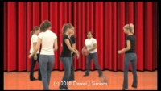
Watch the video

Slide 4
From the video earlier
Which animal appears? A gorilla
How many players are there on each team? Three
What color are the balls they are playing with? Orange
What is the color of the shirt of the player that leaves? Black
What color is the curtain at the start? Red
What color is the curtain at the end? Gold

Slide 5
1. Your attention is THE most precious thing

Slide 6
2. Everyone’s working memory is limited

Slide 7
3. Thinking moves things to your long-term memory

Slide 8
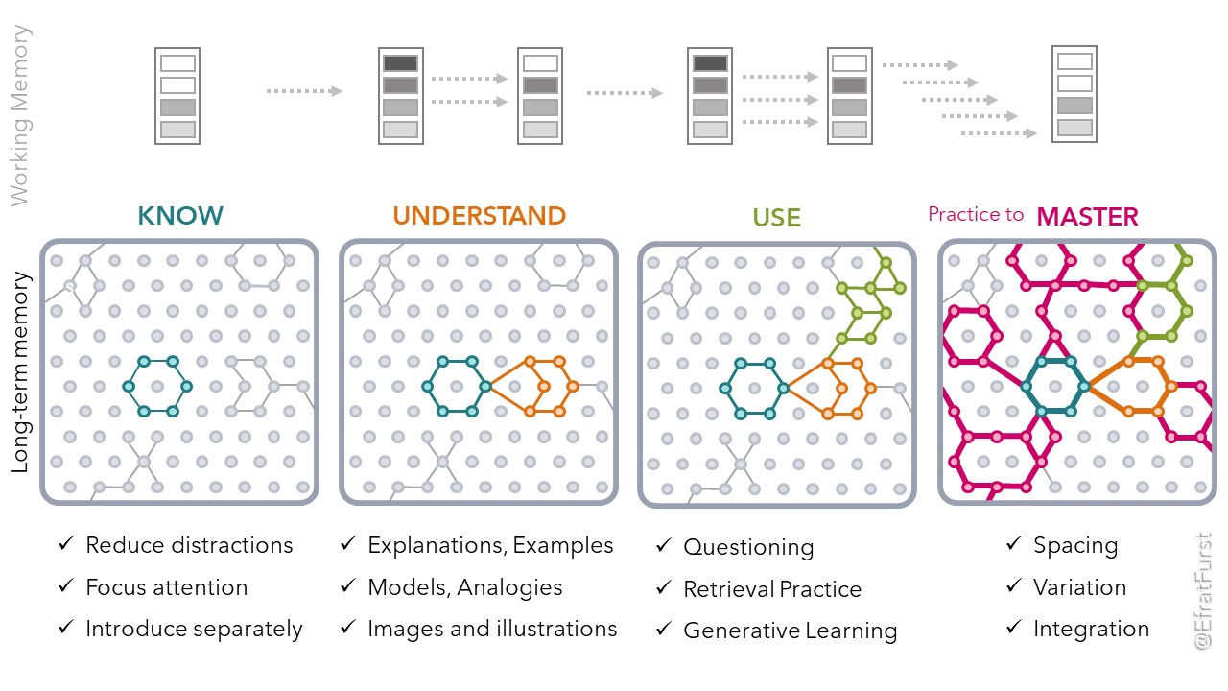

Slide 9
…and forgetting is part of learning

Slide 10
Why did we watch that video?

Slide 11
Your attention is THE most precious thing you have

Slide 12
What you need to know about attention
It’s evolution.
You are programmed to
have a wide, less focussed view (so you don’t get eaten)
have a narrow, focussed view (so you know what to eat)
notice new things (that might help you survive/mate/get fed)

Slide 13
Three things to think about!

Slide 14
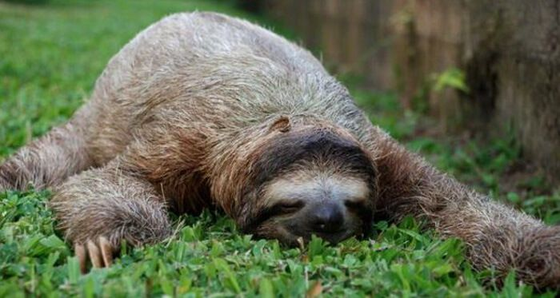
How alert are you?
You need to be alert to learn.

Slide 15
What affects how alert you are?
Ideas on a whiteboard!

Slide 16
What affects how alert you are?
Sleep
Food
What else?

Slide 17
Attention checklist!
Be alert!

Slide 18
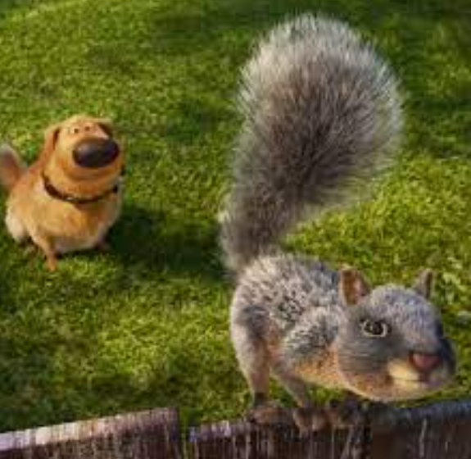
If you ARE alert… what are you focusing on?
You need to focus on the right thing

Slide 19
What could you be focusing on (that’s not the work!)?
In your head | In the room | Other?
Things that have happened Things that might happen | Someone near you

Slide 20
Attention checklist!
Be alert!
Focus on the work!

Slide 21
… and if you ARE focusing on the right thing…
…are you making efforts?
Learning takes effort.
(If it’s easy, you’re probably not learning anything.)

Slide 22
Attention checklist!
Be alert!
Focus on the work!
Make efforts!

Slide 23
How can you maximize your attention?
You’re going to learn most if you are
  alert
  concentrating on the right thing
  applying effort
  (trying even if it is hard, asking for help if you need it)
We will use the acronym ACE.

Slide 25
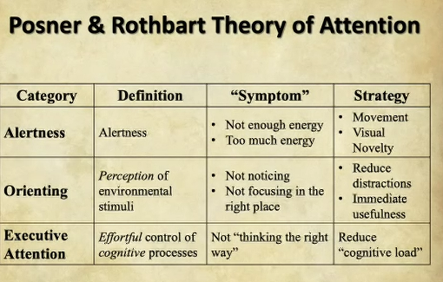

Slide 26
References
@ResearchEDCanada presentation by Andrew Watson, author of The Goldilocks Map, author of Learning and the Brain blog.

