Slide 1
A review!

Slide 2
From the video
Which animal appears?
How many players are there on each team?
What color are the balls they are playing with?
What is the color of the shirt of the player that leaves?
What color is the curtain at the start?
What color is the curtain at the end?

Slide 3
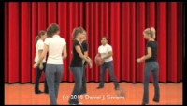
Watch the video

Slide 4
From the video earlier
Which animal appears? A gorilla
How many players are there on each team? Three
What color are the balls they are playing with? Orange
What is the color of the shirt of the player that leaves? Black
What color is the curtain at the start? Red
What color is the curtain at the end? Gold

Slide 5
1. Your attention is THE most precious thing

Slide 6
2. Everyone’s working memory is limited

Slide 7
3. Thinking moves things to your long-term memory

Slide 8
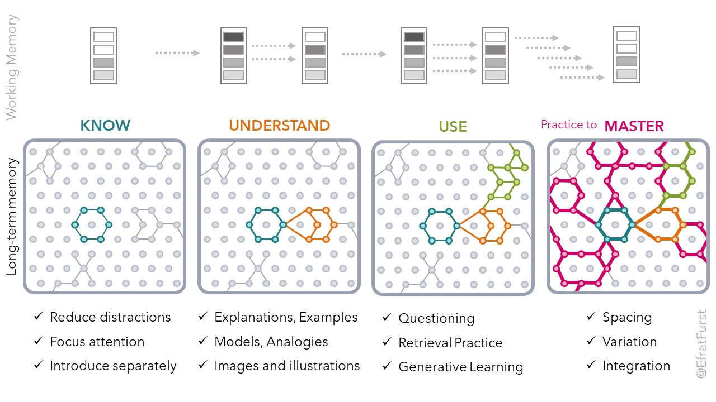

Slide 9
…and forgetting is part of learning

Slide 10
Why did we watch the video?

Slide 11
Your attention is THE most precious thing you have

Slide 12
What you need to know about attention
It’s evolution.
You are programmed to
have a wide, less focussed view (so you don’t get eaten)
have a narrow, focussed view (so you know what to eat)
notice new things (that might help you survive/mate/get fed)

Slide 13
Attention has three categories…

Slide 14

How alert are you?
You need to be alert to learn.

Slide 15
What affects how alert you are?
Ideas on a whiteboard!

Slide 16
What affects how alert you are?
Sleep
Food
Hydration
What else?

Slide 17
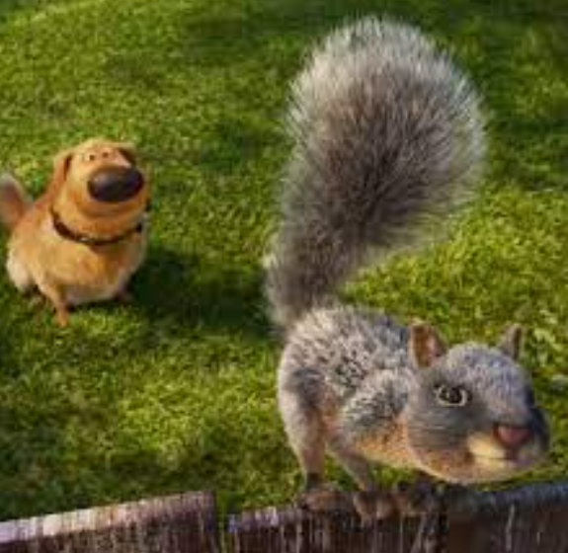
If you ARE alert… what are you concentrating on?
You need to concentrate on the right thing.

Slide 18
What CAN you be concentrating on?
In your head | In the room | Other?

Slide 19
What CAN you be concentrating on?
In your head | In the room | Other?
Things that have happened Things that might happen | Your phone Someone near you

Slide 20
If you ARE concentrating on the right thing…
…are you applying effort?
If you can do it already, that’s not learning – it SHOULD require your effort...
BUT practice is useful.
… but sometimes we all need to ask for help.

Slide 21

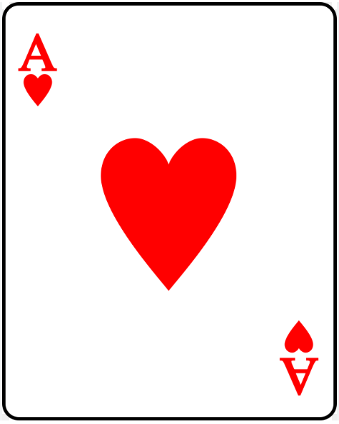
How can you maximize your efforts?
You’re going to learn most if you are
  alert
  concentrating on the right thing
  engaging with it in the right way (applying effort)
  (trying even if it is hard, asking for help if you need it)
We will use the acronym ACE.

Slide 22
What can happen?
On your whiteboard… a situation where you are
Alert but not concentrating on the right thing?
Concentrating on the right thing but not putting in effort?
Can you be…
Not alert but concentrating on the right thing?
Alert and putting effort in, but not concentrating?

Slide 23
References
@ResearchEDCanada presentation by Andrew Watson, author of The Goldilocks Map, author of Learning and the Brain blog.

Slide 24
