Slide 1
Learning

Slide 2
What is ‘learning’?
Learning is a change to your long-term memory.

Slide 3
So is ‘learning’ all about facts?
No.
You need to know things to be able to do things
When you learn you can
‘know’ new things
make new connections to old things
make new connections between old things
strengthen the connections between any of the things

Slide 4
So what do I need to know about learning?
During lessons I will talk about
Attention
Working memory
Long-term memory

Slide 5
1. Your attention is a precious thing

Slide 6















Notes:
Students have 30 seconds to look at the items.

Slide 8


Slide 10
What did we learn
Our attention is precious
(so, I will try not to distract you, and this is why the presentation is simple)

Slide 11
2. Everyone’s working memory is limited

Slide 12
What can you do?
Reduce the things going into your brain so that you can focus
No other tabs/games open during lessons

Slide 13
3. Thinking moves things to your long-term memory

Slide 14
This is a REALLY GOOD IDEA because your LONG-TERM MEMORY IS HUGE.

Slide 15
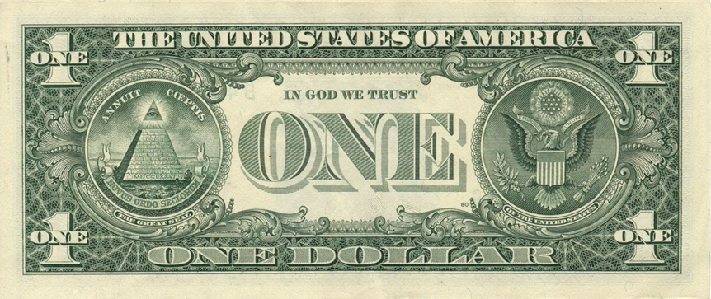
Here’s some questions…
Where were you last Thanksgiving?
What are the pictures on the back of a dollar bill?

Slide 16
Most people find it easier to remember things that mean something.
Why?
You have to think what the words mean.
When we think about meaning, we remember it more easily.

Slide 17
…and forgetting is part of learning

Slide 18
From the school last year
What was the last topic you studied in science?
What were three things you learned in that topic?
Describe a problem that you can solve using one of those three things.

Slide 19
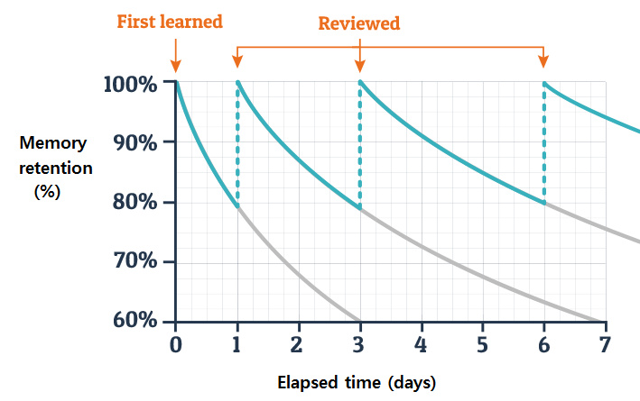
Retrieving things upsets the forgetting curve

Slide 20
What will we do this year?
To get things securely in your long-term memory and upset the forgetting curve we will do…
lots of retrieval practice (lots of questions but NOT about grading)
lots of SLOP – Shed Loads Of Practice (to make strong connections)
lots of spaced practice (thinking about things from a while ago)
You’ll use your working memory to process new information
You’ll build up your long-term memory to be better at everything.

Slide 21
BIG three things
Attention - what you think about is what you learn
Working memory – control what is using it up
Long-term memory - the more you know the easier it is to learn

Slide 23
A couple of brain games to finish…

Slide 24
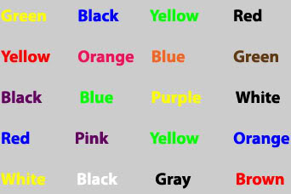
Say the COLOUR not the word
The first one is yellow not green

Slide 25
Look at this for 30 seconds

Slide 26



Slide 27
…now look at your hand.

Slide 28
What’s going on??
Come up with your own theory for these observations:
Naming the color takes longer
You to get it wrong more often

Slide 29
This is the Stroop Effect
Why? There are several theories
You aren’t used to recognizing colors, so you are slower (processing speed theory)
Reading is automatic, recognizing color isn’t (automaticity theory)
Recognizing color requires more attention, so takes longer (selective attention theory)
There are different pathways for different types of information, and the pathway for information from reading is stronger (not faster) than the rest, so wins (parallel processing theory)
(so we don’t know why)

Slide 30
References/credits
https://www.ambition.org.uk/research-and-insight/learning-curriculum/
Daniel Willingham: Why don’t student’s like school

